Slide 1
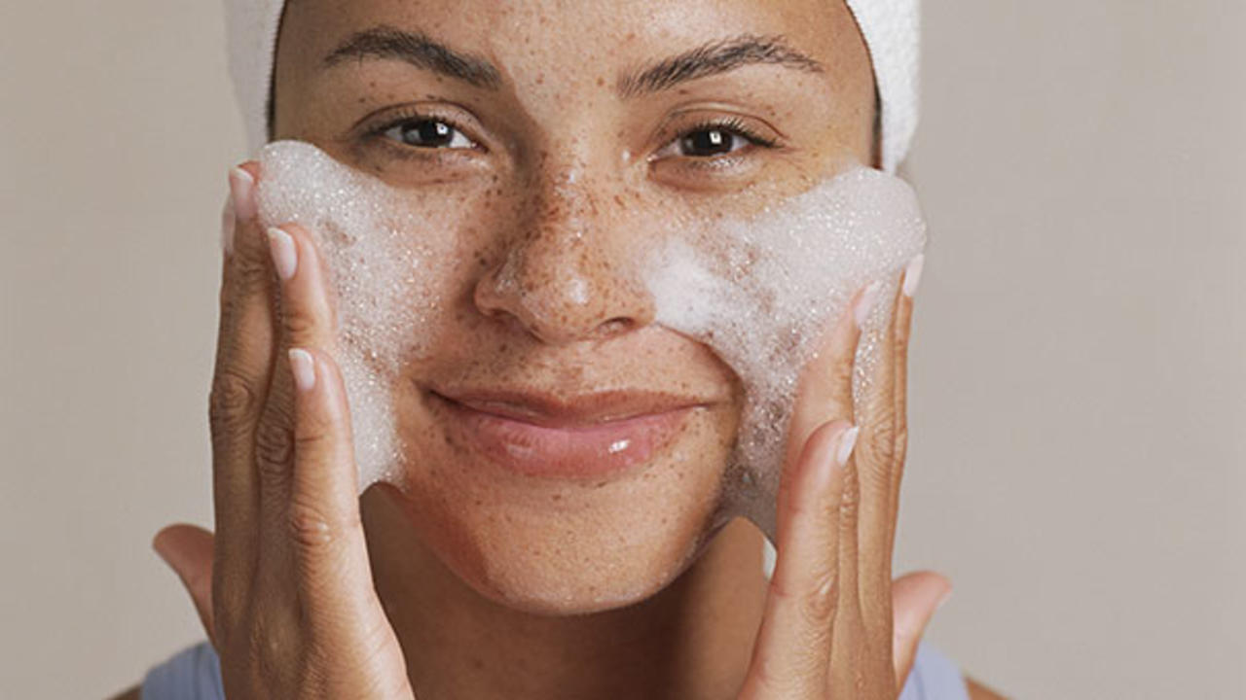
Skincare Routine Recommender
By Mackenzie Mitchell

Slide 2
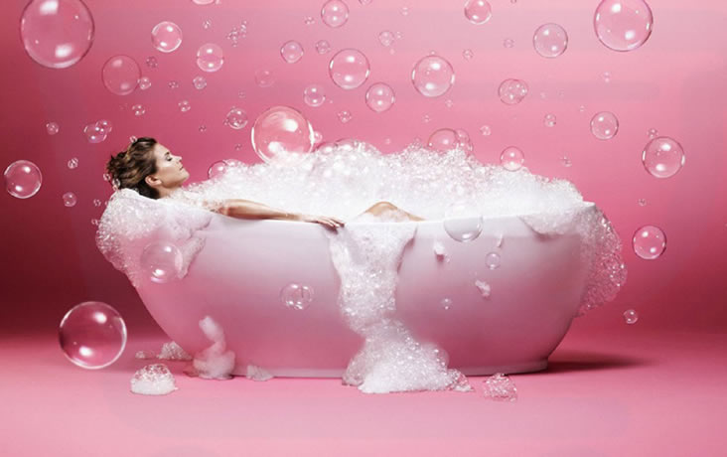
Offer an easy and accessible way for consumers to find the right set of skincare products for their skin problems.

Slide 3
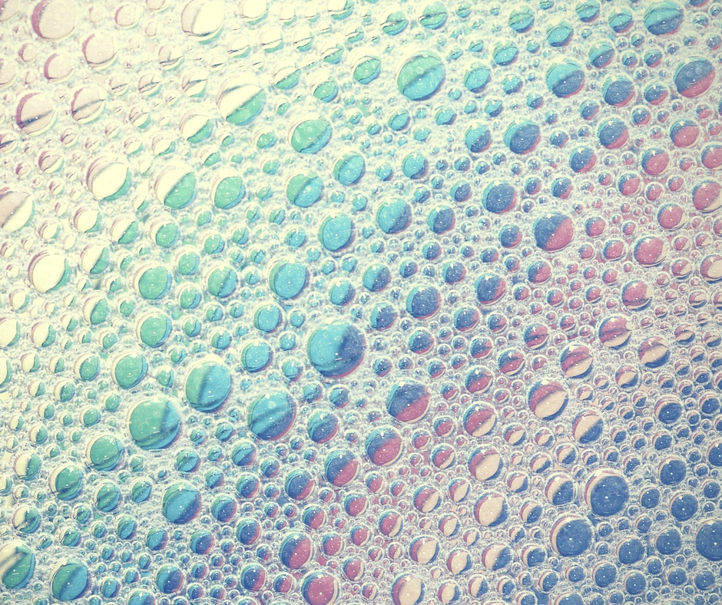
Data
Obtained by web scraping SkinStore.com
1,700 skin care products from 102 brands with almost 3,300 reviews total from almost 1,400 users
Some products with only one rating, some 5 star products with many ratings

Slide 4

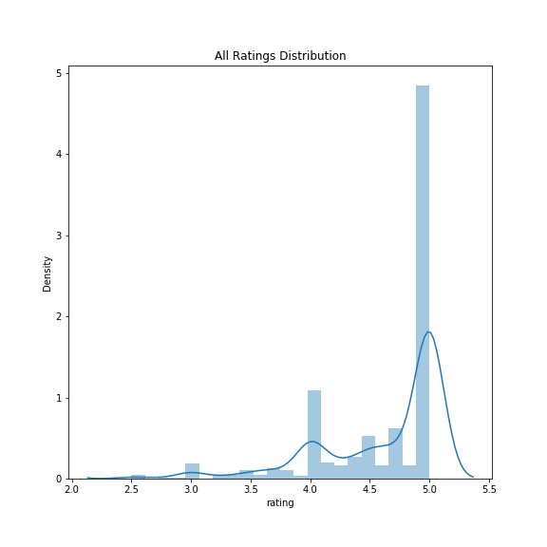

EDA

Slide 5

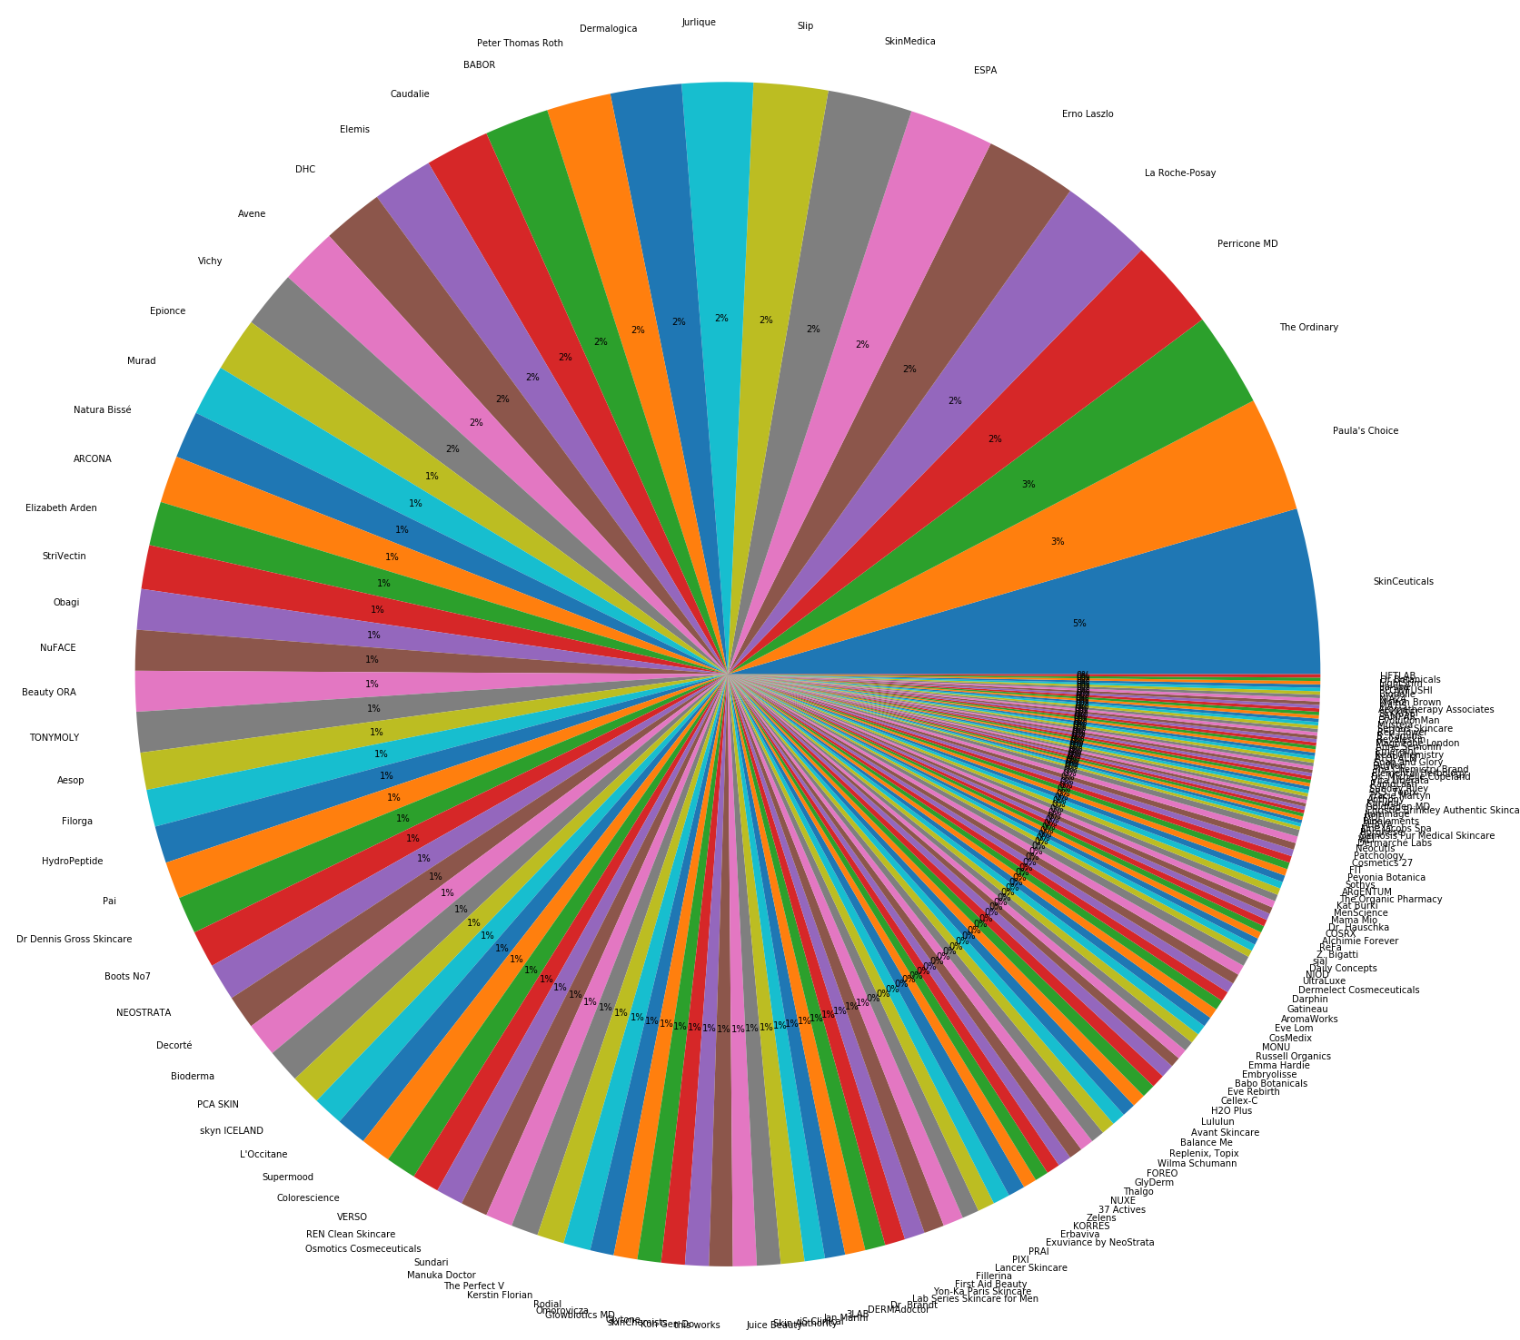
Brands

Slide 6
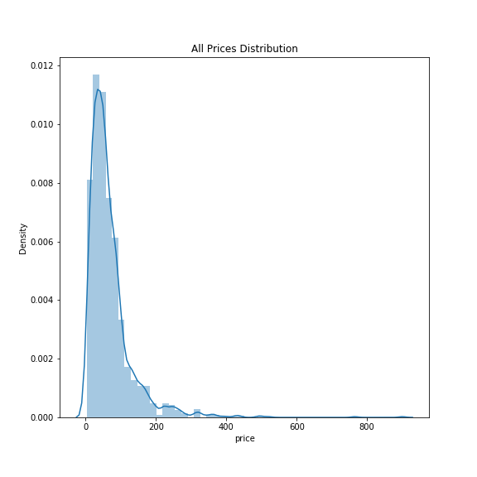
Prices

Slide 7
Ratings

Slide 8
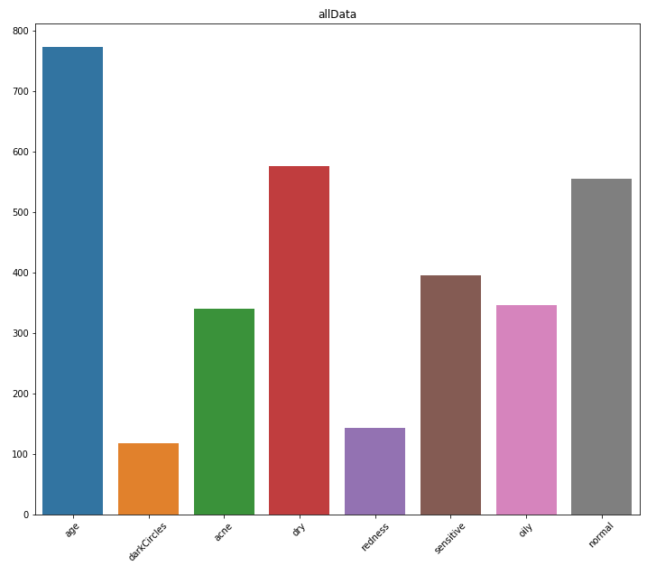
Skin
Problems

Slide 9
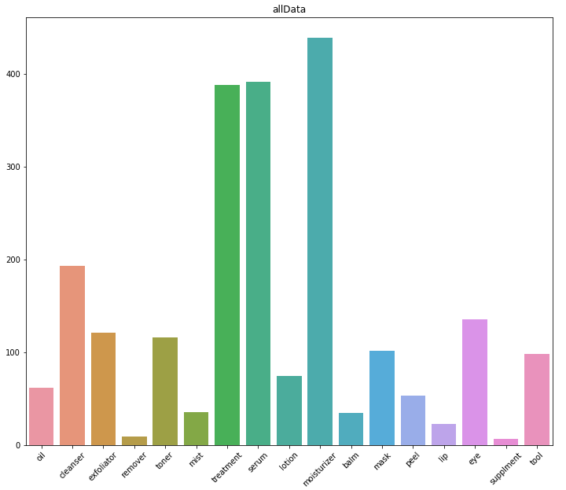
Product
Types

Slide 10
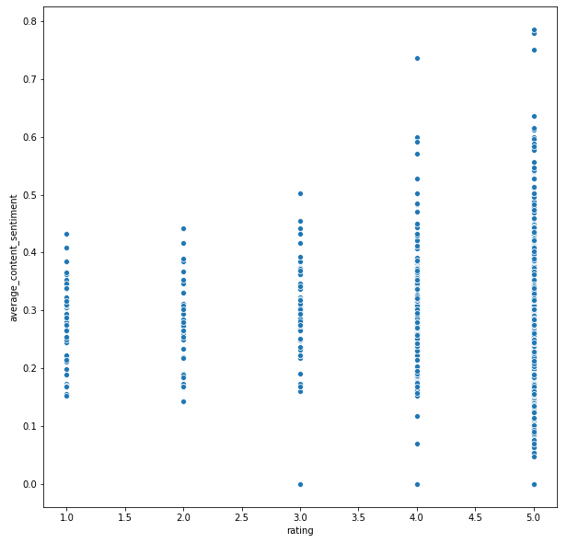
Ratings vs.
Average Review Content
Sentiment

Slide 11
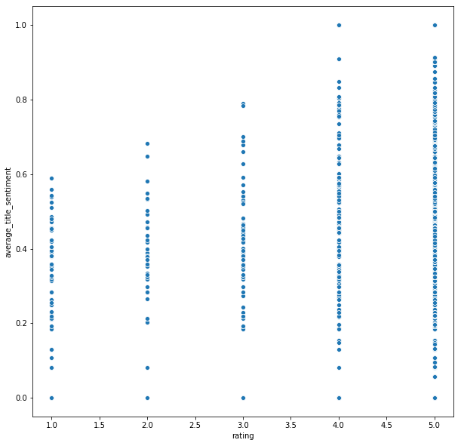
Ratings vs.
Average Review
Title
Sentiment

Slide 12
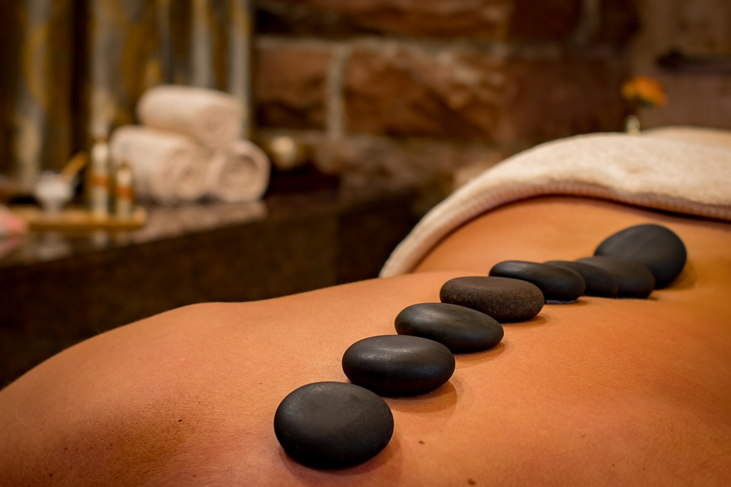
Modeling

Slide 13
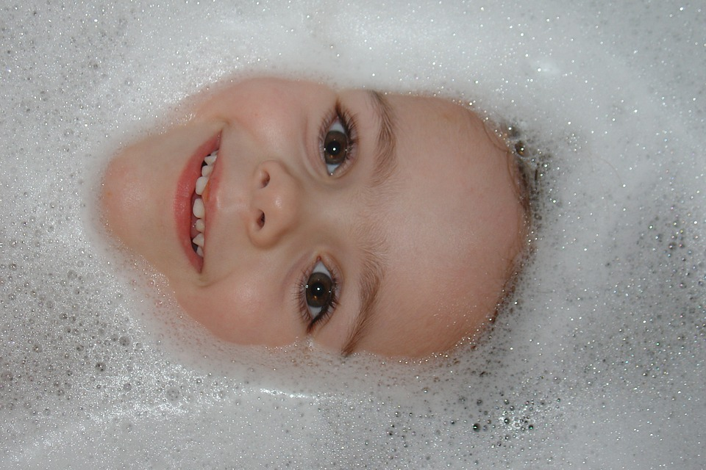
0.96 RMSE
The best fit model was a KNN Baseline model using the pearson baseline metric while not utilizing the user based approach.

Slide 14
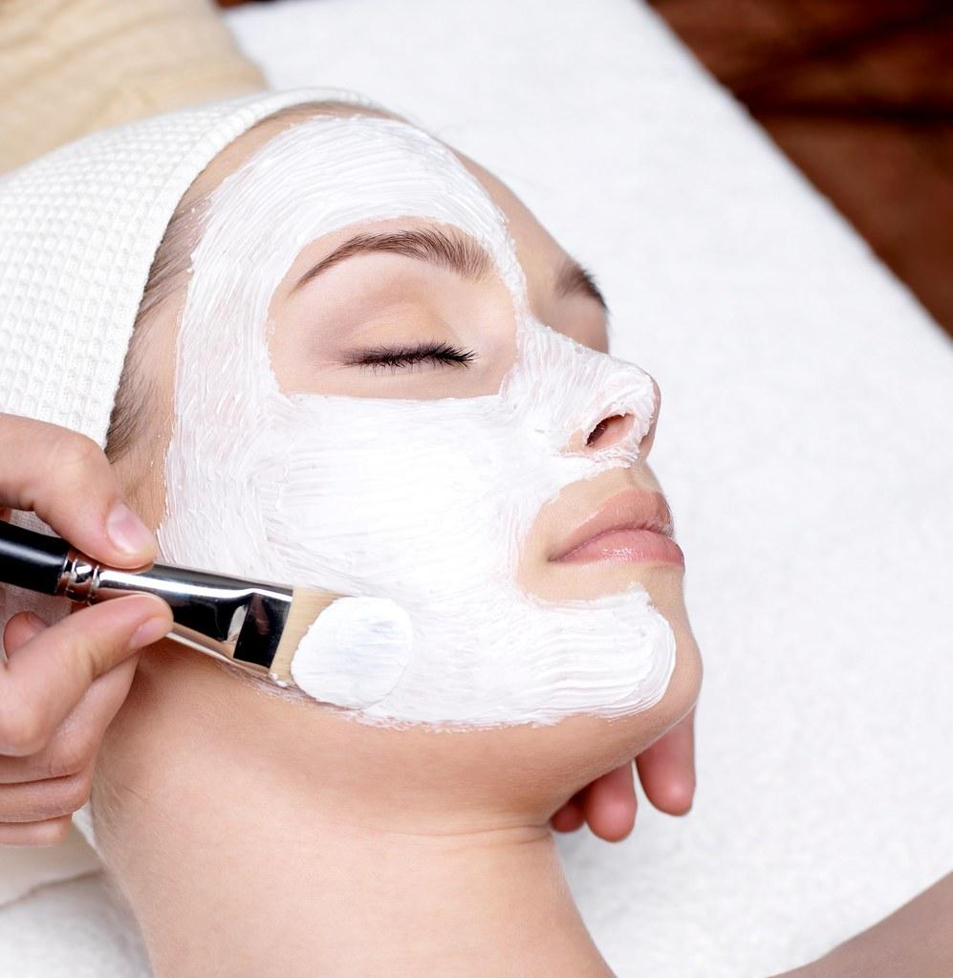
Recommender

Slide 15
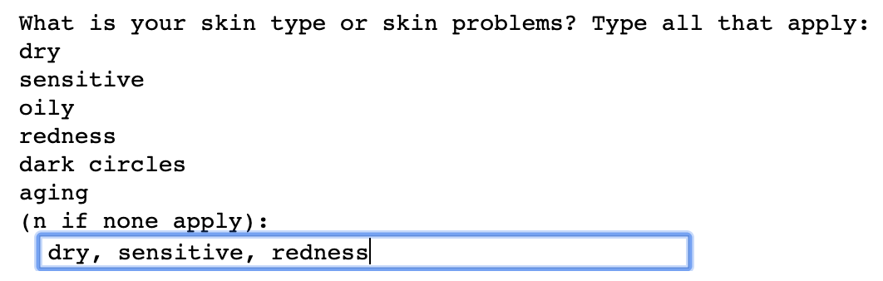
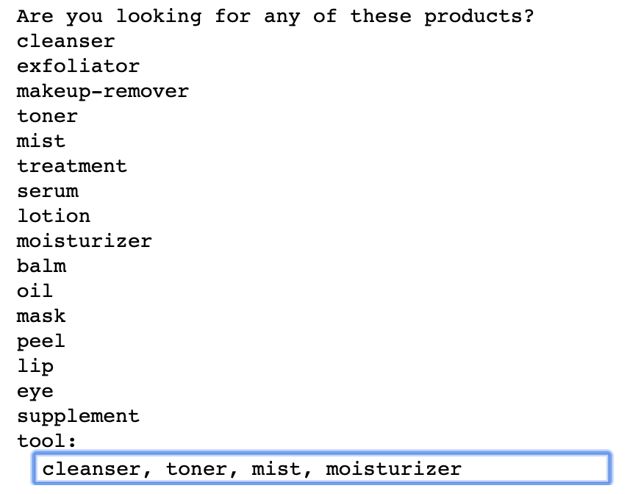

Slide 16
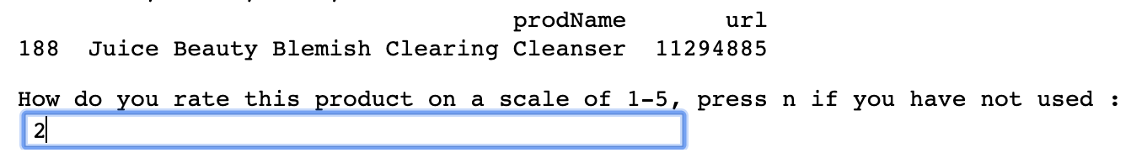
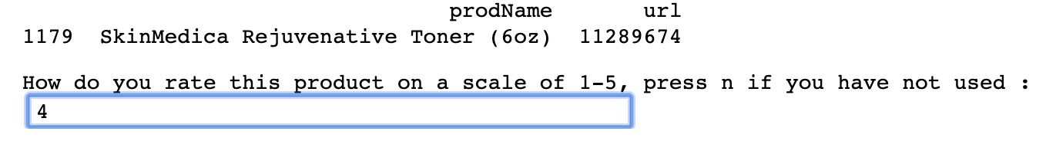
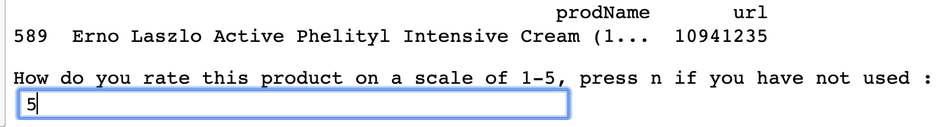
Cleanser
Toner
Moisturizer

Slide 17
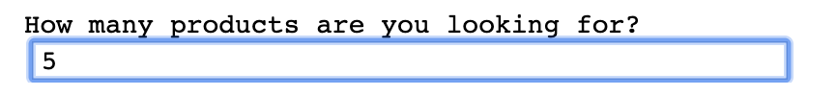
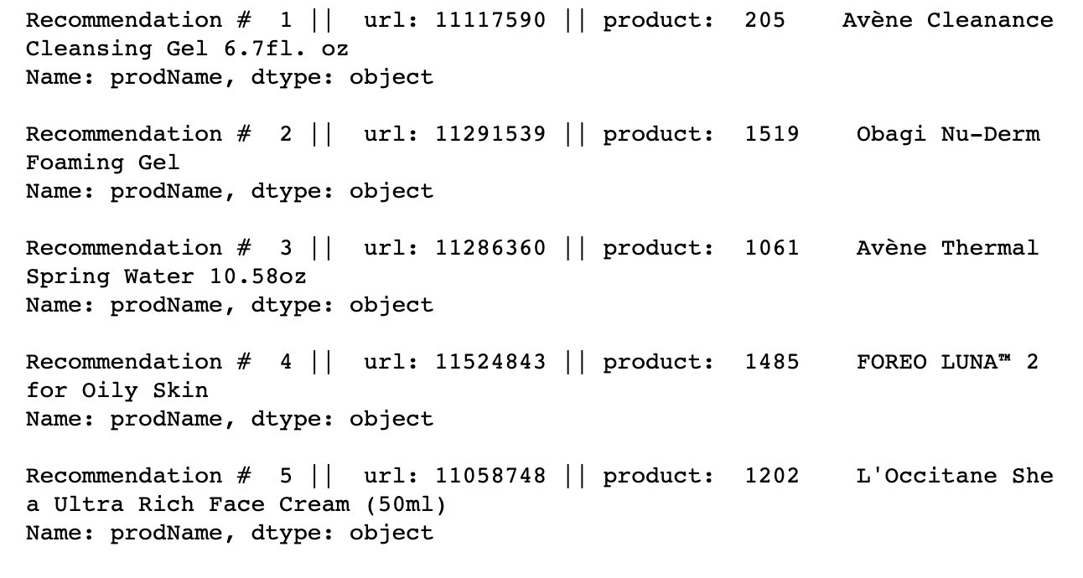
Cleanser
Cleanser
Mist/Moisturizer/Toner
Cleansing Tool :/
Moisturizer

Slide 18
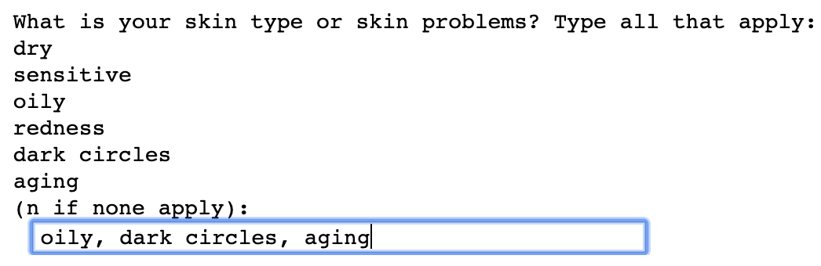

Slide 19
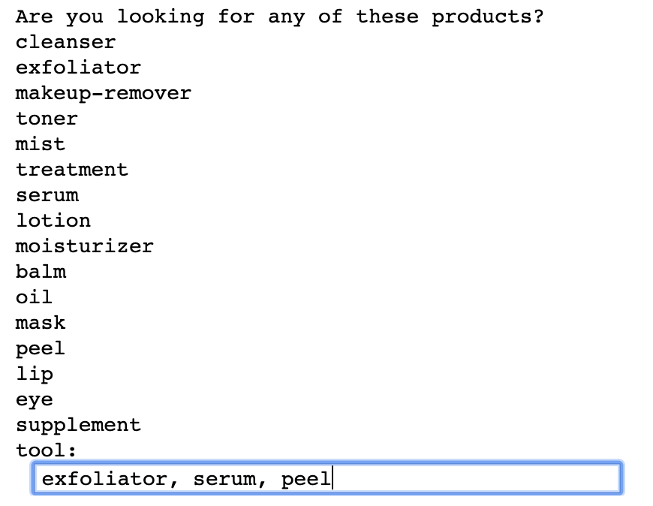

Slide 20
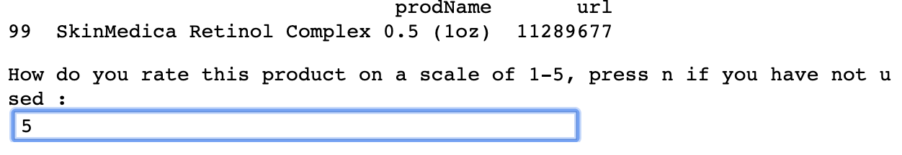
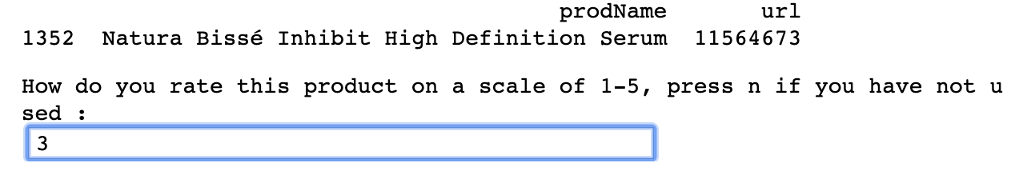
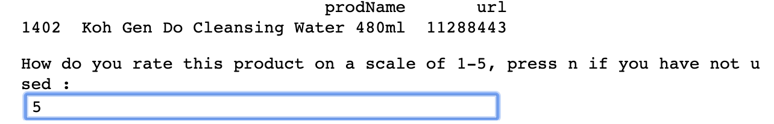
Helps with redness
Serum
Makeup-remover

Slide 21
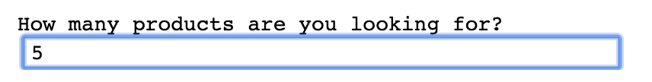
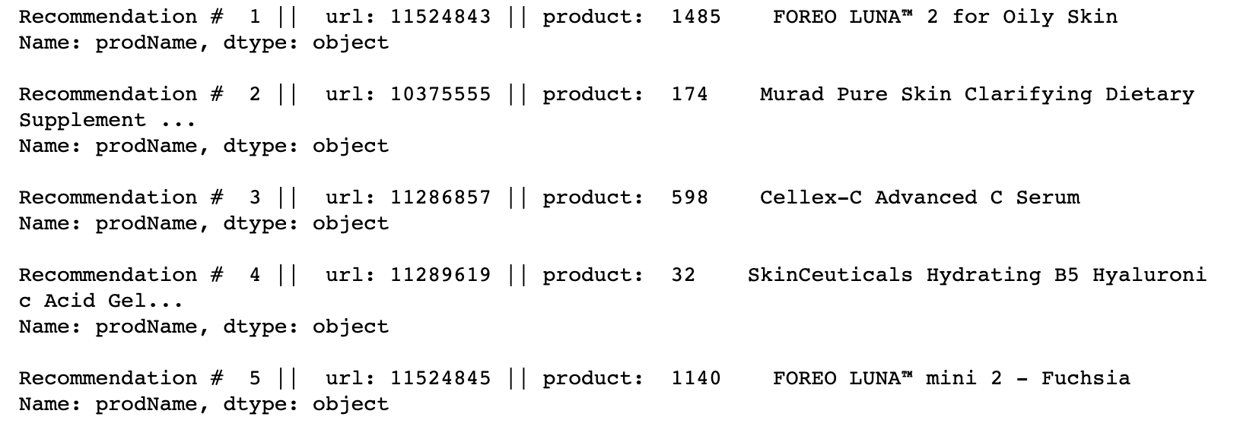
Cleanser Tool For
Oily Skin
Supplement
Serum
Serum/Peel
Mini Traveling
Cleanser Tool :/

Slide 22
Conclusions
One cleansing tool is frequently recommended and may need to be removed from the dataset.
In the future, I would like to ensure that at least one of each of the product types that the user requests is recommended.

